Slide 1
Penambahan ESG Menu
Level 1

Slide 2
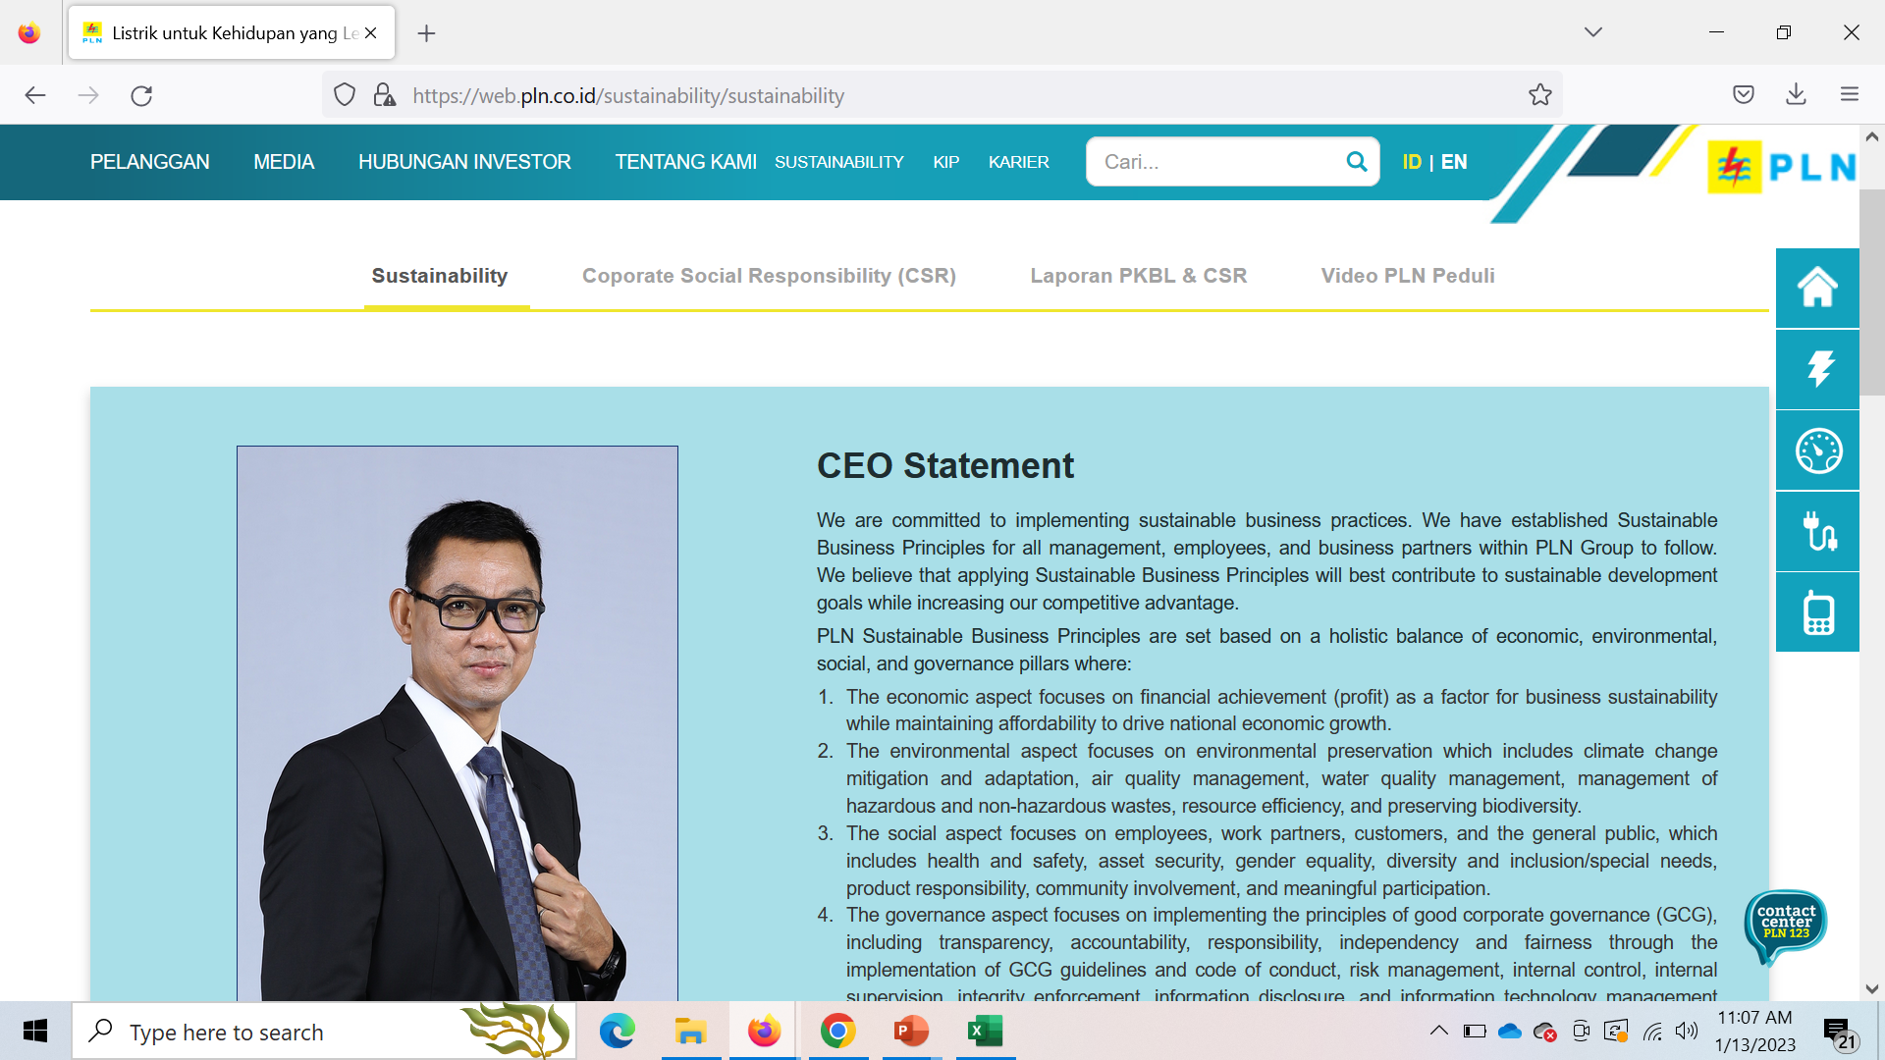
PLN ESG Framework
PLN ESG Journey
ESG KPI Dashboard
ESG Performance Report
TCFD Report

Slide 3
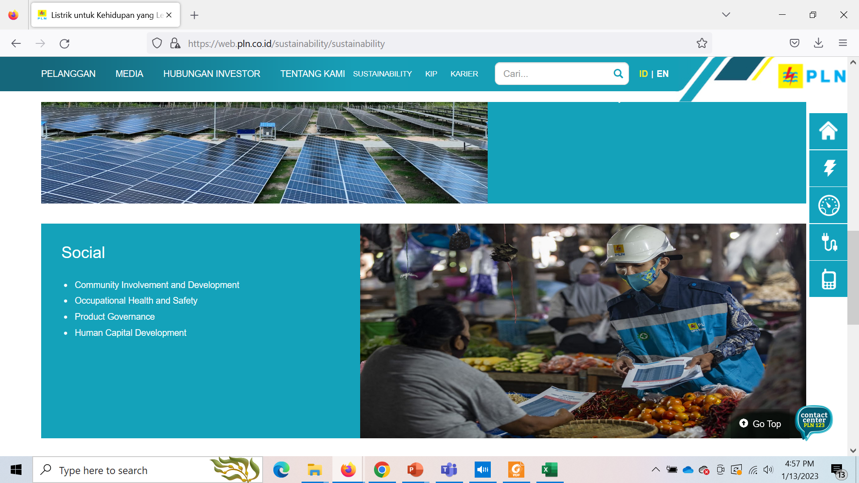
Diganti jadi :
Gender Equality, Disability & Social Inclusion

Slide 4
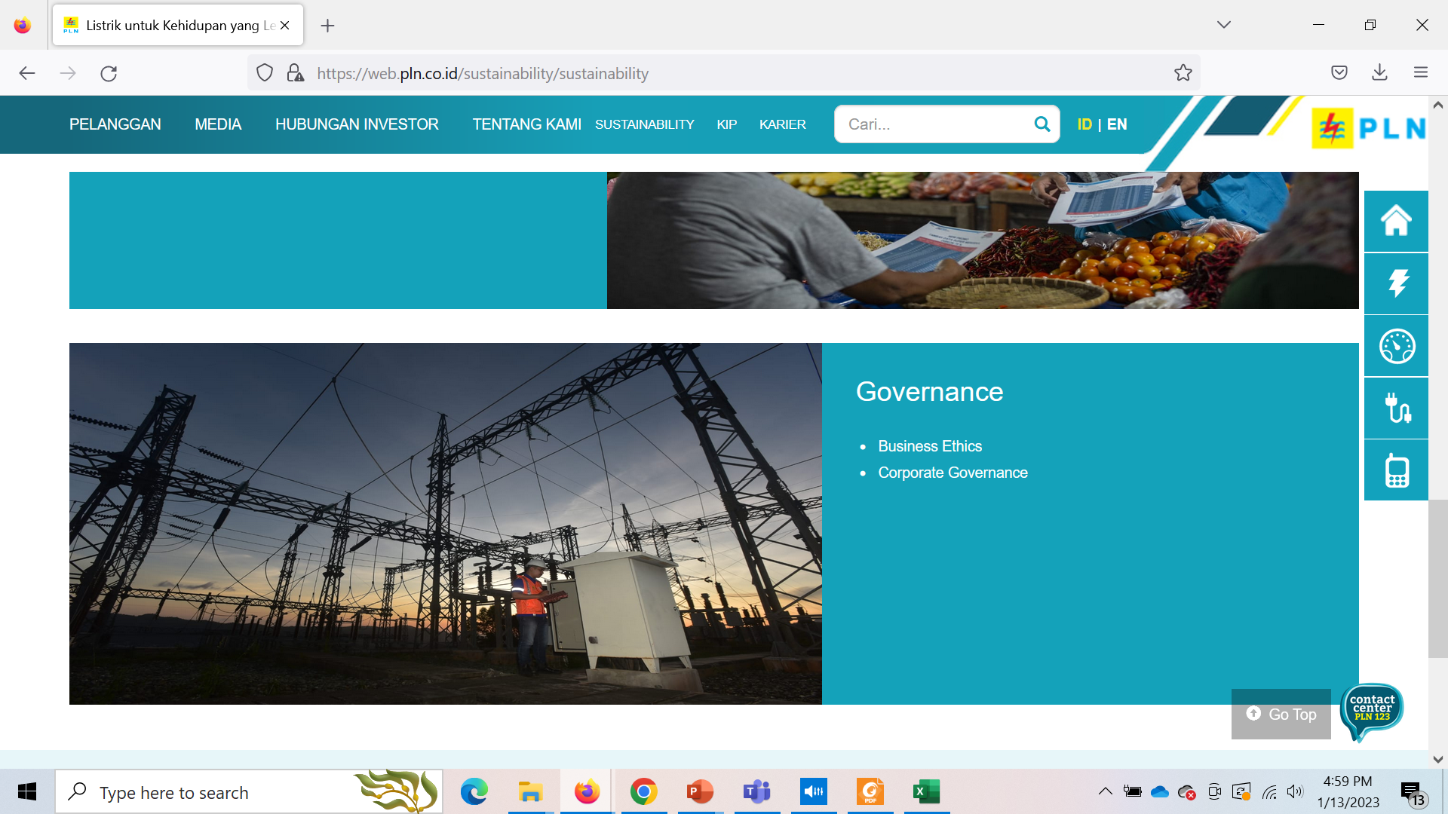
Ditambahkan:
Occupational Health & Safety

